Slide 1
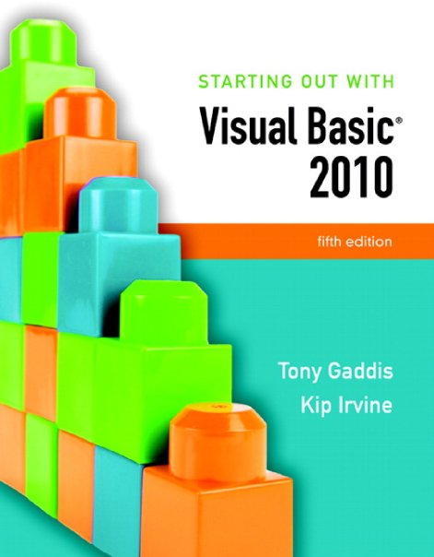

Slide 2
Chapter 5
Lists and Loops

Slide 3
Introduction
This chapter introduces:
Input boxes
List and combo boxes
Loops
Random numbers
The ToolTip control

Slide 4
Input Boxes
Section 5.1
Input boxes provide a simple way to gather input without placing a
text box on a form.

Slide 5
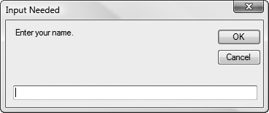
Overview
An input box provides a quick and simple way to ask the user to enter data
User types a value in the text box
OK button returns a string value containing user input
Cancel button returns an empty string
Should not be used as a primary method of input
Convenient tool for developing & testing applications

Slide 6
General Format
InputBox(Prompt [,Title] [,Default] [,Xpos] [,Ypos])
Argument | Description
Prompt | String displayed in the input box, normally asks the user for a value
[Optional arguments]
Title | String that appears in the title bar, contains project name by default
Default | String to be initially displayed in the text box, empty by default
Xpos | Integer that specifies the distance (in pixels) of the leftmost edge of the input box from the left edge of the screen, centered horizontally by default
Ypos | Integer that specifies the distance (in pixels) of the topmost edge of the input box from the top of the screen, placed near the top of the screen by default

Slide 7
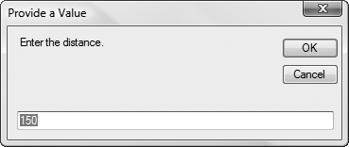
Example Usage
To retrieve the value returned by the InputBox function, use the assignment operator to assign it to a variable
For example, the following statement assigns the string value returned by the InputBox function to the string variable strUserInput
The string value that appears inside the text box will be stored in the strUserInput variable after the OK button is clicked and the input box closes
Dim strUserInput As String = InputBox("Enter the distance.",
"Provide a Value",
"150")

Slide 8
List Boxes
Section 5.2
List boxes display a list of items and allow the user to select an
item from the list.

Slide 9
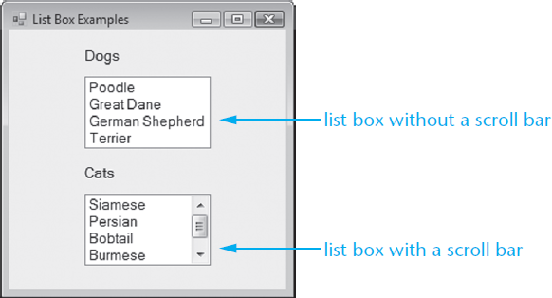
Overview
A ListBox control displays a list of items and also allows the user to select one or more items from the list
Displays a scroll bar when all items cannot be shown
To create a ListBox control:
Double-click the ListBox icon in the Toolbox window
Position and resize the control as necessary
In Design mode, the list box appears as a rectangle
The size of the rectangle determines the size of the list box
Use the lst prefix when naming a list box (lstListBox)

Slide 10
The Items Property
The entries in a list box are stored in a property named Items
The Items property holds an entire list of values from which the user may choose
The list of values may be established at design time or runtime
Items are stored in a Collection called the Items Collection

Slide 11

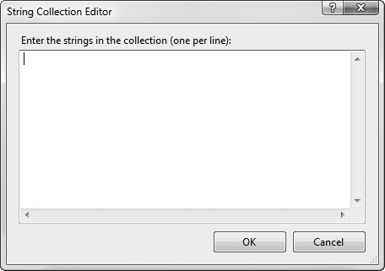
Adding Items to the Items Collection
To store values in the Items property at design time:
Select the ListBox control in the Designer window
In the Properties window, click the Items (Collection) ellipsis button (...)
Type each value on a separate line in the String Collection Editor dialog box

Slide 12
The Items.Count Property
The Items.Count property returns the number of list box items or zero if the list is empty
For example, the Items.Count return value:
Can be used in an If statement:
Or assigned to a variable
If lstEmployees.Items.Count = 0 Then
MessageBox.Show("The list has no items!")
End If
IntNumEmployees = lstEmployees.Items.Count

Slide 13
Item Indexing
The Items property values can be accessed from your VB code
Each item value is given a sequential index
The first item has an index of 0
The second item has an index of 1, etc.
When assigning an item to a variable, you must explicitly convert the item to the same data type as the variable
Examples:
strName = lstCustomers.Items(2).ToString()
intRoomNumber = CInt(lstRoomNumbers.Items(0))

Slide 14
Handling Exceptions Caused by Indexes
An exception is thrown if an index is out of range
An exception handler can be used to trap indexing errors
Some programmers prefer to use an If statement to handle indexing errors
Try
strInput = lstMonths.Items(intIndex).ToString()
Catch ex As Exception
MessageBox.Show(ex.Message)
End Try
If intIndex >= 0 And intIndex < lstMonths.Items.Count Then
strInput = lstMonths.Items(intIndex).ToString()
Else
MessageBox.Show("Index is out of range: " & intIndex)
End If

Slide 15
The SelectedIndex Property
The SelectedIndex property returns an integer with the index of the item selected by the user
If no item is selected, the value is set to -1 (an invalid index value)
Can use SelectedIndex to determine if an item has been selected by comparing to -1
Example:
If lstLocations.SelectedIndex <> -1 Then
strLocation = lstLocations.Items(lstLocations.SelectedIndex).ToString()
End If

Slide 16
The SelectedItem Property
The SelectedItem property contains the currently selected item from the list box
For example:
If lstItems.SelectedIndex <> -1
strItemName = lstItems.SelectedItem.ToString()
End If

Slide 17
The Sorted Property
Sorted is a Boolean property
When set to True, values in the Items property are displayed in alphabetical order
When set to False, values in the Items property are displayed in the order they were added
Set to False by default

Slide 18
The Items.Add Method
To store values in the Items property with code at runtime, use the Items.Add method
Here is the general format:
ListBox is the name of the ListBox control
Item is the value to be added to the Items property
Example:
ListBox.Items.Add(Item)
lstStudents.Items.Add("Sharon")

Slide 19
The Items.Insert Method
To insert an item at a specific position, use the Items.Insert method
General Format:
ListBox is the name of the ListBox control
Index is an integer value for the position where Item is to be placed in the Items collection
Item is the item you wish to insert
Items that follow are moved down
For example:
ListBox.Items.Insert(Index, Item)
lstStudents.Items.Insert(2, "Jean")

Slide 20
Methods to Remove Items
ListBox.Items.RemoveAt(Index)
Removes item at the specified Index
ListBox.Items.Remove(Item)
Removes item with value specified by Item
ListBox.Items.Clear()
Removes all items in the Items property
Examples:
lstStudents.Items.RemoveAt(2) ' Remove 3rd item
lstStudents.Items.Remove("Jean") ' Remove item "Jean"
lstStudents.Items.Clear() ' Remove all items

Slide 21
Other List Box Methods
ListBox.Items.Contains(Item)
Returns True if Item is found in the collection
ListBox.Items.IndexOf(Item)
Returns an integer with the index position of the first occurrence of Item in the collection
Examples:
Tutorial 5-1 provides more examples of list box controls, methods and properties
blnFound = lstMonths.Items.Contains("March")
intIndex = lstMonths.Items.IndexOf("March")

Slide 22
Important Collection Methods and Properties
Method or Property | Description
Add (item As Object) | Method: adds item to the collection, returning its index position
Clear ( ) | Method: removes all items in the collection. No return value
Contains (value As Object) | Method: returns True if value is found at least once in the collection.
Count | Property: returns the number of items in the collection. Read-only
IndexOf (value As Object) | Method: returns the Integer index position of the first occurrence of value in the collection. If value is not found, the return value is –1
Insert (index As Integer, item As Object) | Method: insert item in the collection at position index. No return value
Item (index As Integer) | Property: returns the object located at position index
Remove (value As Object) | Method: removes value from the collection. No return value
RemoveAt (index As Integer) | Method: removes the item at the specified index. No return value

Slide 23
Introduction to Loops: The Do While Loop
Section 5.3
A loop is a repeating structure that contains a block of program
statements.

Slide 24
Introduction
A repetition structure, or loop causes one or more statements to repeat
Each repetition of the loop is called an iteration
Visual Basic has three types of loops:
Do While
Do Until
For… Next
The difference among them is how they control the repetition

Slide 25
The Do While Loop
The Do While loop has two important parts:
a Boolean expression that is tested for a True or False value
a statement or group of statements that is repeated as long as the Boolean expression is true, called Conditionally executed statements
Do While BooleanExpression
statement
(more statements may follow)
Loop
Expression true?
Process
True
False

Slide 26
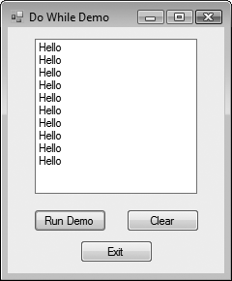
Example Do While Loop
intCount initialized to 0
Expression intCount < 10 is tested
If True, execute body:
"Hello" added to lstOutput Items Collection
intCount increases by 1
Test expression again
Repeat until intCount < 10 becomes False
Dim intCount As Integer = 0
Do While intCount < 10
lstOutput.Items.Add("Hello")
intCount += 1
Loop

Slide 27
Infinite Loops
A loop must have some way to end itself
Something within the body of the loop must eventually force the test expression to false
In the previous example
The loop continues to repeat
intCount increases by one for each repetition
Finally intCount is not < 10 and the loop ends
If the test expression can never be false, the loop will continue to repeat forever
This is called an infinite loop

Slide 28
Counters
A counter is a variable that is regularly incremented or decremented each time a loop iterates
Increment means to add 1 to the counter’s value
intX = intX + 1
intX += 1
Decrement means to subtract 1 from the counter’s value
intX = intX - 1
intX -= 1
Counters generally initialized before loop begins
' Start at zero
Dim intCount As Integer = 0
Counter must be modified in body of loop
' Increment the counter variable
intCount += 1
Loop ends when of value counter variable exceeds the range of the test expression
' False after ten iterations
intCount < 10

Slide 29
Pretest and Posttest Do While Loops
Previous Do While loops are in pretest form
Expression is tested before the body of the loop is executed
The body may not be executed at all
Do While loops also have a posttest form
The body of the loop is executed first
Then the expression is evaluated
Body repeats as long as expression is true
A posttest loop always executes the body of the loop at least once

Slide 30
The Posttest Do While Loop
The Do While loop can also be written as a
posttest loop:
While BooleanExpression appears
after the Loop keyword
Tests its Boolean expression after
each loop iteration
Will always perform at least one iteration,
even if its Boolean expression is false to start with
Statement(s)
Do
Statement
(More statements may follow)
Loop While BooleanExpression
Boolean
Expression
True
False

Slide 31
Example Posttest Do While Loop
intCount is initialized to 100
The statements in the body of the loop execute
The expression intCount < 10 is tested
The expression is False
The loop stops after the first iteration
Tutorial 5-3 modifies Tutorial 5-2 to use a posttest Do While Loop
Dim intCount As Integer = 100
Do
MessageBox.Show("Hello World!")
intCount += 1
Loop While intCount < 10
Dim intCount As Integer = 100
Do
MessageBox.Show("Hello World!")
intCount += 1
Loop While intCount < 10

Slide 32
Keeping a Running Total
Many programming tasks require you to calculate the total of a series of numbers
Sales Totals
Scores
This calculation generally requires two elements:
A loop that reads each number in the series and accumulates the total, called a running total
A variable that accumulates the total, called an accumulator

Slide 33
Logic for Keeping a Running Total
Set accumulator to 0
Setting the accumulator variable to zero
before entering the loop is a critical step
Is there another number to read?
Yes
(True)
Read the next number
Add the number to the accumulator
No
(False)

Slide 34
A Posttest Running Total Loop
Const intNUM_DAYS = 5 ' Number days
Dim intCount As Integer = 1 ' Loop counter
Dim decSales As Decimal ' Daily sales
Dim decTotal As Decimal = 0 ' Total sales
Dim strInput As String ' Input string
' Get sales for each day.
Do
' Get daily sales amount from the user.
strInput = InputBox("Enter the sales for day"
& intCount.ToString())
' Convert user input string to a decimal.
If Decimal.TryParse(strInput, decSales) Then
decTotal += decSales ' Increment total
intCount += 1 ' Input counter
Else
MessageBox.Show("Enter a number.")
End If
Loop While intCount <= intNUM_DAYS
Tutorial 5-4 uses the code shown here in pretest form as part of a more complete example
Tutorial 5-5 demonstrates how to structure a loop such that the user can specify the iterations

Slide 35
The Do Until and For...Next Loops
Section 5.4
The Do Until loop iterates until its test expression is true. The
For...Next loop uses a counter variable and iterates a specific
number of times.

Slide 36
The Do Until Loop
A Do Until loop iterates until an expression is true
Repeats as long as its test expression is False
Ends when its test expression becomes True
Can be written in either pretest or posttest form
Tutorial 5-6 provides a hands-on example of a pretest Do Until loop
Pretest General Format:
Do Until BooleanExpression
Statement
(More statements may follow)
Loop
Posttest General Format:
Do
Statement
(More statements may follow)
Loop Until BooleanExpression

Slide 37
The For...Next Loop
Ideal for loops that require a counter, pretest form only
For, To, and Next are keywords
CounterVariable tracks number of iterations
StartValue is initial value of counter
EndValue is counter number of final iteration
Optional Step Increment allows the counter to increment at a value other than 1 at each iteration of the loop
For CounterVariable = StartValue To EndValue [Step Increment]
statement
(more statements may follow)
Next [CounterVariable]

Slide 38
Example of For…Next Loop
Step 1: intCount is set to 1 (the start value)
Step 2: intCount is compared to 10 (the end value)
If intCount is less than or equal to 10
Continue to Step 3
Otherwise the loop is exited
Step 3: The MessageBox.Show("Hello") statement is executed
Step 4: intCount is incremented by 1
Step 5: Go back to Step 2 and repeat this sequence
For intCount = 1 To 10
MessageBox.Show("Hello")
Next
For intCount = 1 To 10
MessageBox.Show("Hello")
Next

Slide 39
Flowchart of For…Next Loop
Set intCount to 1
intCount
<= 10?
Display "Hello"
Add 1 to intCount
Yes
No

Slide 40
Specifying a Step Value
The step value is the value added to the counter variable at the end of each iteration
Optional and if not specified, defaults to 1
The following loop iterates 10 times with counter values 0, 10, 20, …, 80, 90, 100
Step value may be negative, causing the loop to count downward
For intCount = 0 To 100 Step 10
MessageBox.Show(intCount.ToString())
Next
For intCount = 10 To 1 Step -1
MessageBox.Show(intCount.ToString())
Next

Slide 41
Summing a Series of Numbers
The For...Next loop can be used to calculate the sum of a series of numbers
Dim intCount As Integer ' Loop counter
Dim intTotal As Integer = 0 ' Accumulator
' Add the numbers 1 through 100.
For intCount = 1 To 100
intTotal += intCount
Next
' Display the sum of the numbers.
MessageBox.Show("The sum of 1 through 100 is " & intTotal.ToString())

Slide 42
Breaking Out of a Loop
In some cases it is convenient to end a loop before the test condition would end it
The following statements accomplish this
Exit Do (used in Do While or Do Until loops)
Exit For (used in For…Next loops)
Use this capability with caution
It bypasses normal loop termination
Makes code more difficult to debug

Slide 43
Deciding Which Loop to Use
Each type of loop works best in different situations
The Do While loop
When you wish the loop to repeat as long as the test expression is true or at least once as a pretest loop
The Do Until loop
When you wish the loop to repeat as long as the test expression is false or at least once as a pretest loop
The For…Next loop
Primarily used when the number of required iterations is known
Start Here Tonight

Slide 44
Nested Loops
Section 5.5
A loop that is contained inside another loop is called a nested loop.

Slide 45
Introduction
A nested loop is a loop inside another loop
The hands of a clock make a good example
The hour hand makes 1 revolution for every 60 revolutions of the minute hand
The minute hand makes 1 revolution for every 60 revolutions of the second hand
For every revolution of the hour hand the second hand makes 36,000 revolutions

Slide 46
Nested Loop Example
The simulated clock example contains
An outer loop for the hours
A nested middle loop for the minutes
A nested inner loop for the seconds
For intHours = 0 To 23
lblHours.Text = intHours.ToString()
For intMinutes = 0 To 59
lblMinutes.Text = intMinutes.ToString()
For intSeconds = 0 To 59
lblSeconds.Text = intSeconds.ToString()
Next
Next
Next

Slide 47
Nested Loop Example Analysis
The innermost (seconds) loop will iterate 60 times for each iteration of the middle (minutes) loop
The middle (minutes) loop will iterate 60 times for each iteration of the outermost (hours) loop
24 iterations of the outermost (hours) loop require:
1,440 iterations of the middle (minutes) loop
86,400 iterations of the innermost (seconds) loop
An inner loop goes through all its iterations for each iteration of the outer loop
Multiply iterations of all loops to get the total iterations of the innermost loop

Slide 48
Multicolumn List Boxes, Checked List Boxes, and Combo Boxes
Section 5.6
A multicolumn list box displays items in columns with a horizontal
scroll bar, if necessary. A checked list box displays a check box next
to each item in the list. A combo box performs many of the same
functions as a list box, and it can also let the user enter text.

Slide 49
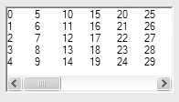
Multicolumn List Boxes
ListBox control has a Multicolumn property
Boolean property with default value of False
If set to True, entries can appear side by side
Below, ColumnWidth is set to 30
Note the appearance of a horizontal scroll bar in this case

Slide 50
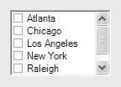
Checked List Boxes
A form of ListBox with the list box properties and methods already discussed
One item at a time may be selected but many items in a Checked List Box can be checked
The CheckOnClick property determines how items may be checked
False - user clicks item once to select it, again to check it
True - user clicks item only once to both select it and check it

Slide 51
Finding the Status of Checked Items
The GetItemChecked method determines if an item is checked by returning a Boolean value
General Format:
Returns True if the item at Index has been checked
Otherwise, returns False
CheckedListBox.GetItemChecked(Index)

Slide 52
GetItemsChecked Example
The following code counts the number of checked items:
Dim intIndex As Integer ' List box index
Dim intCheckedCities As Integer = 0 ' To count the checked cities
' Step through the items in the list box, counting
' the number of checked items.
For intIndex = 0 To clbCities.Items.Count - 1
If clbCities.GetItemChecked(intIndex) = True Then
intCheckedCities += 1
End If
Next
' Display the number of checked cities.
MessageBox.Show("You checked " & intCheckedCities.ToString() &" cities.")

Slide 53
Combo Boxes Similar to List Boxes
Both display a list of items to the user
Both have Items, Items.Count, SelectedIndex, SelectedItem, and Sorted properties
Both have Items.Add, Items.Clear, Items.Remove, and Items.RemoveAt methods
These properties and methods work the same with combo boxes and list boxes

Slide 54
Additional Combo Box Features
A combo box also functions like a text box
The combo box has a Text property
The user may enter text into a combo box
Or the user may select the text from a series of list box type choices
In code, we use the cbo prefix when naming combo boxes

Slide 55



Combo Box Styles
Simple Combo Box
List is always shown
Drop-down Combo Box
List appears when user clicks down arrow
User can type text or select

Slide 56
Combo Box Styles
Drop-down List Combo Box
Behaves like a Drop-Down Combo Box, but the user may not enter text directly
Tutorial 5-9 demonstrates the combo box

Slide 57
List Boxes versus Combo Boxes
If restricting the user to select items listed
If empty space
Use list box
If limited space
Use drop-down list combo box
If allowing user to select an item listed or enter an entirely new item
If empty space
Use simple combo box
If limited space
Use drop-down combo box

Slide 58
Random Numbers
Section 5.7
Visual Basic provides tools to generate random numbers and initialize
the sequence of random numbers with a random seed value.

Slide 59
The Random Object
Random numbers are used in games and simulations to create random events
Computers create pseudo-random numbers, which are not truly random
To generate random numbers in Visual Basic, create a Random object reference variable
For example:
Creates a new Random object in memory called rand
The rand variable can be used to call the object’s methods for generating random numbers
Dim rand As New Random

Slide 60
The Next Method
Once you have created a Random object, call its Next method to get a random integer number
Calling Next with no arguments
Generates an integer between 0 and 2,147,483,647
Alternatively, you can specify an integer argument for the upper limit
The following Next method generates a number between 0 and 99
Numeric range does not have to begin at zero
Add or subtract to shift the numeric range upward or downward
intNum = rand.Next()
intNum = rand.Next(100)
intNum = rand.Next(10) + 1
intNum = rand.Next(100) - 50

Slide 61
The NextDouble Method
Call a Random object’s NextDouble method to get a random floating-point number in the range of 0.0 up to (but not including) 1.0
If you want the random number to fall within a larger range, multiply it by a scaling factor
The following statement generates a random number between 0.0 and 500.0
The following statement generates a random number between 100.0 and 600.0
Tutorial 5-10 uses random numbers to simulate a coin toss
dblNum = rand.NextDouble()
dblNum = rand.NextDouble() * 500.0
dblNum = (rand.NextDouble() * 500.0) + 100.0

Slide 62
Random Number Seeds
The seed value is used in the calculation that returns the next random number in the series
Using the same seed value results in the same series of random numbers
The system time, which changes every hundredth of a second, is the preferred seed value used by a Random object in most cases
You can specify the seed value if you desire, when you create a Random object
For example:
1000 as the seed value generates the same series of random numbers
Useful for specific tests and validations
Boring and repetitive for computer games or simulations
Dim rand As New Random(1000)

Slide 63
Simplifying Code with the With...End With Statement
Section 5.8
The With...End With statement allows you to simplify a series of
consecutive statements that perform operations using the same object.

Slide 64
The With...End With Statement
Multiple statements that use the same control or other object
Can be simplified using the With…End With statement
Eliminates the need to repeatedly type the control name
txtName.Clear()
txtName.ForeColor = Color.Blue
txtName.BackColor = Color.Yellow
txtName.BorderStyle = BorderStyle.Fixed3D
With txtName
.Clear()
.ForeColor = Color.Blue
.BackColor = Color.Yellow
.BorderStyle = BorderStyle.Fixed3D
End With

Slide 65
ToolTips
Section 5.9
ToolTips are a standard and convenient way of providing help to
the users of an application. The ToolTip control allows you to assign
pop-up hints to the other controls on a form.

Slide 66
What is a Tool Tip?
A Tool Tip is the short text message you see when holding the mouse over a control
These are easy to set up and use in Visual Basic forms
The ToolTip control allows you to create tool tips for other controls on a form

Slide 67
Adding a ToolTip Control
Display the form in Design view
Double-click the ToolTip tool in the Toolbox
The ToolTip control is invisible at runtime
It appears in the component tray, not the form
Component tray is a resizable region at the bottom of the Design window that hold invisible controls
Form controls now have a ToolTip property
This new property holds the text string that will be displayed for that control

Slide 68
ToolTip Properties
Select the ToolTip control from the tray
View Properties window to see the following
An InitialDelay property that regulates the delay before a tip appears
An AutoPopDelay property that determines how long a tip is displayed
The ReshowDelay property determines the time between the display of different tips as the user moves the mouse from control to control
Tutorial 5-11 demonstrates adding tool tips to a form

Slide 69
Focus on Program Design and Problem Solving: Building the Vehicle Loan Calculator Application
Section 5.10
In this section, you build the Vehicle Loan Calculator application.
The application uses a loop, input validation, and ToolTips. This section
also covers some of the Visual Basic intrinsic financial functions.

Slide 70
Introduction
Visual Basic has several built-in functions for performing financial calculations
You will build a program named Vehicle Loan Calculator
It uses the following functions:
Pmt
Ipmt
PPmt

Slide 71
The Pmt Function
The Pmt function returns the periodic payment amount for a loan with a fixed interest rate
PeriodicInterestRate is the rate of interest per period
NumberOfPeriods is the total number of months
LoanAmount is the amount being borrowed, must be negative
For example:
dblAnnInt holds the annual interest rate
24 is the number of months of the loan
The amount of the loan is $5000
dblPayment holds the fixed monthly payment amount
Pmt(PeriodicInterestRate, NumberOfPeriods, –LoanAmount)
dblPayment = Pmt(dblAnnInt / 12, 24, -5000)

Slide 72
The IPmt Function
The IPmt function returns the interest payment for a specific period of a loan with a fixed interest rate and fixed monthly payments
PeriodicInterestRate is the rate of interest per period
Period is the period for which you would like the payment
NumberOfPeriods is the total number of months
LoanAmount is the amount being borrowed, must be negative
For example:
dblAnnInt holds the annual interest rate
6 is the number of the month for which to calculate the payment
24 is the number of months of the loan
The amount of the loan is $5000
dblInterest holds the amount of interest paid in month 6 of the loan
IPmt(PeriodicInterestRate, Period, NumberOfPeriods, –LoanAmount)
dblInterest = IPmt(dblAnnInt / 12, 6, 24, -5000)

Slide 73
The PPmt Function
The PPmt function returns the principal payment for a specific period on a loan with a fixed interest rate and fixed monthly payments
PeriodicInterestRate is the rate of interest per period
Period is the period for which you would like the payment
NumberOfPeriods is the total number of months
LoanAmount is the amount being borrowed, must be negative
For example:
dblAnnInt holds the annual interest rate
6 is the number of the month for which to calculate the payment
24 is the number of months of the loan
The amount of the loan is $5000
dblPrincipal holds the amount of principal paid in month 6 of the loan
PPmt(PeriodicInterestRate, Period, NumberOfPeriods, –LoanAmount)
dblPrincipal = PPmt(dblAnnInt / 12, 6, 24, -5000)

Slide 74
The Case Study
A credit union branch manager asks you to write an application named Vehicle Loan Calculator that displays the following information for a loan:
The monthly payment amount
The amount of the monthly payment applied toward interest
The amount of the monthly payment applied toward principal
The credit union currently charges
8.9% annual interest for new vehicle loans
9.5% annual interest on used vehicle loans

Slide 75
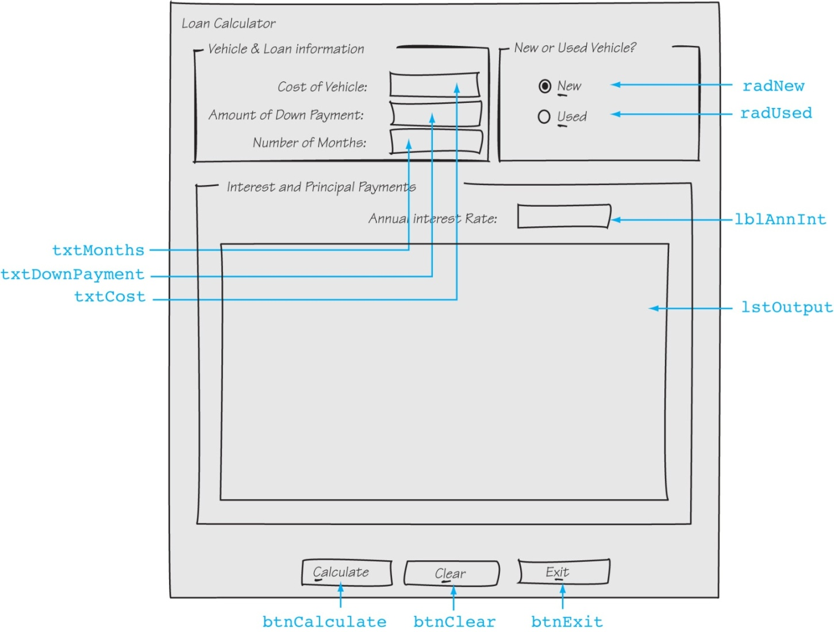
Sketch of the Vehicle Loan Calculator Form

Slide 76
Event Handlers
Method | Description
btnCalculate_Click | Calculates and displays a table in the list box showing interest and principal payments for the loan
btnClear_Click | Resets the interest rate, clears the text boxes, and clears the list box
btnExit_Click | Ends the application
radNew_CheckedChanged | Updates the annual interest rate if the user selects a new vehicle loan
radUsed_CheckedChanged | Updates the annual interest rate if the user selects a used vehicle loan

Slide 77
btnCalculate_Click Event Handler Pseudocode
The pseudocode does not indicate input validation, and the actual arguments
that need to be passed to the Pmt, IPmt, and PPmt functions are not shown
Get VehicleCost from the form
Get DownPayment from the form
Get Months from the form
Loan = VehicleCost – DownPayment
MonthlyPayment = Pmt()
For Count = 0 To Months
Interest = IPmt()
Principal = PPmt()
Display Month, Payment, Interest, and Principal in list box
Next

Slide 78
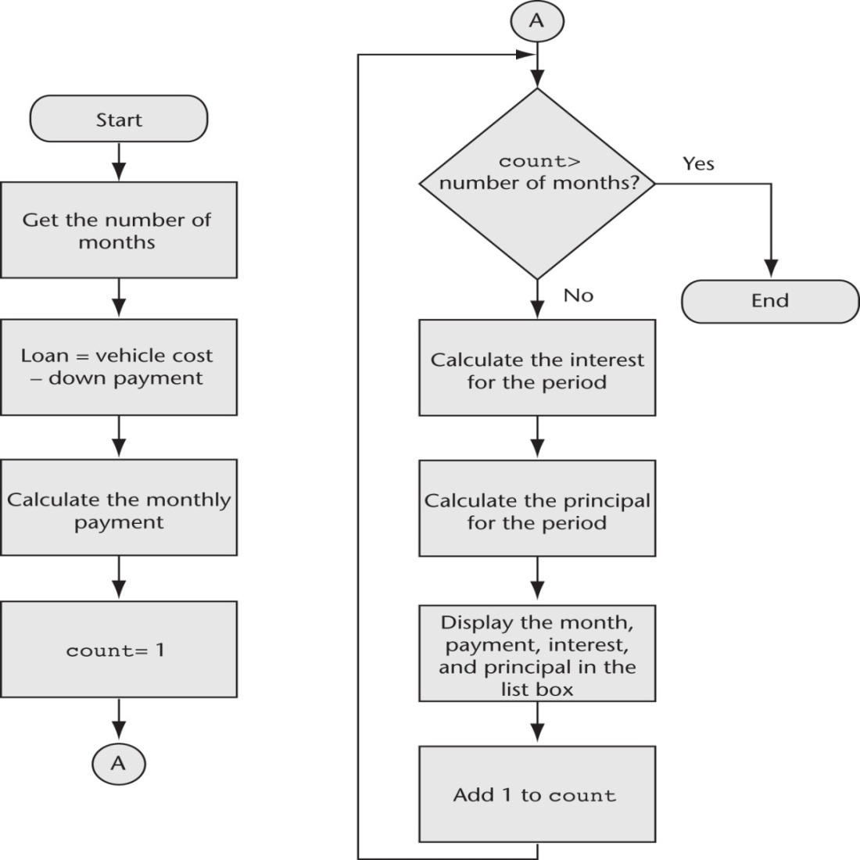
btnCalculate_Click Event Handler Flowchart

Slide 79
radNew_CheckedChanged & radUsed_CheckedChanged Event Handler Pseudocode
If radNew is selected Then
Annual Interest Rate = 0.089
Display Annual Interest Rate in lblAnnInt
End If
If radUsed is selected Then
Annual Interest Rate = 0.095
Display Annual Interest Rate in lblAnnInt
End If

Slide 80
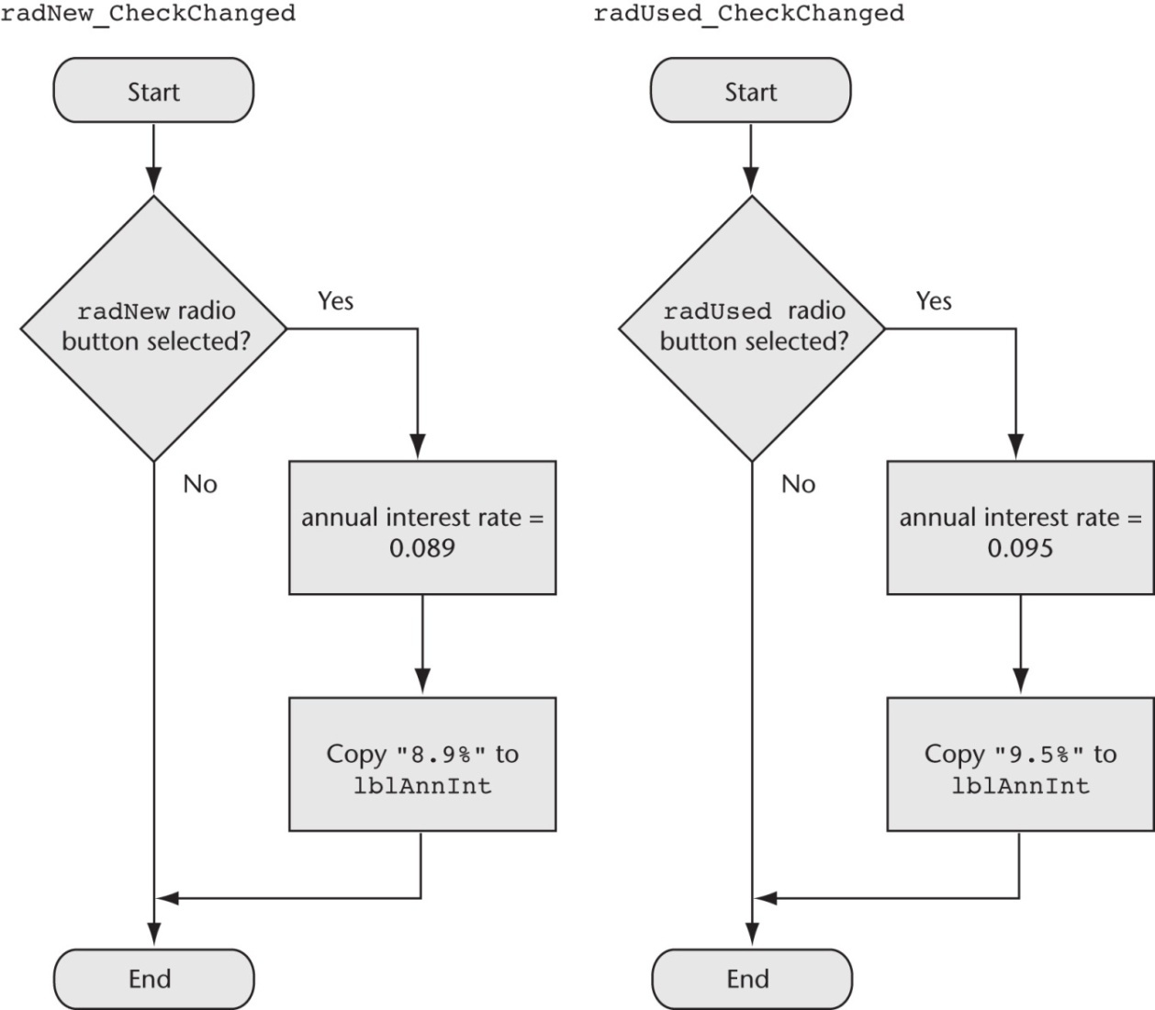
radNew_CheckedChanged & radUsed_CheckedChanged Event Handler Pseudocode

